Slide 1

Ideas to measure the prompt component of the atmospheric muon flux Ludwig Neste and Pascal Gutjahr
IceCeub Spring Collaboration Meeting
Aachen 2023
https://www.vox.com/the-highlight/2019/7/16/17690740/cosmic-rays-universe-theory-science

Slide 2

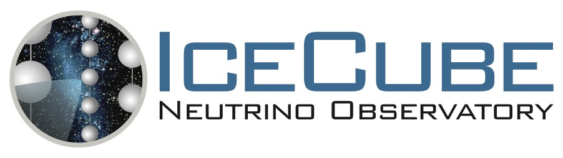


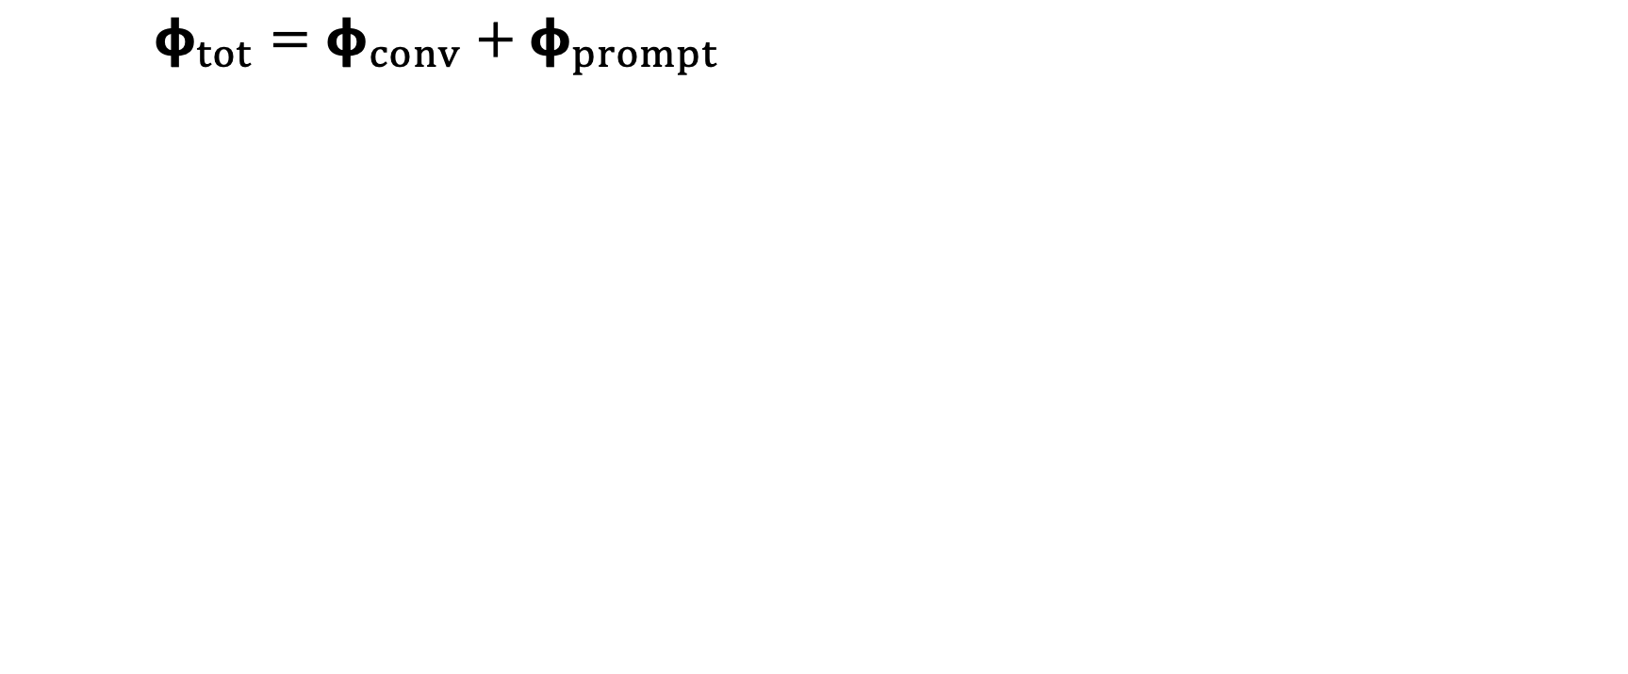
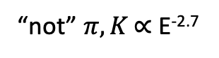
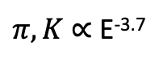
Definition of the muon flux
$φ_{tot}=φ_{conv}+φ_{prompt}$
$π, Κ$ ∝ E^{-3.7}
“not” $π, Κ \text{∝ }\text{E}\text{−}\text{2}\text{.7}$
(all particles with a decay length lower than 0.123 cm
= MCEq definition)

Slide 3
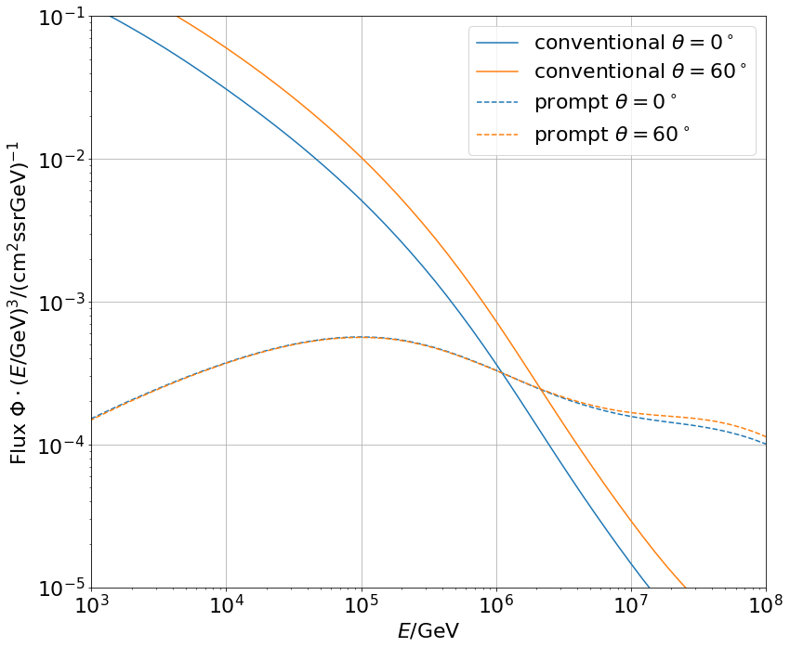
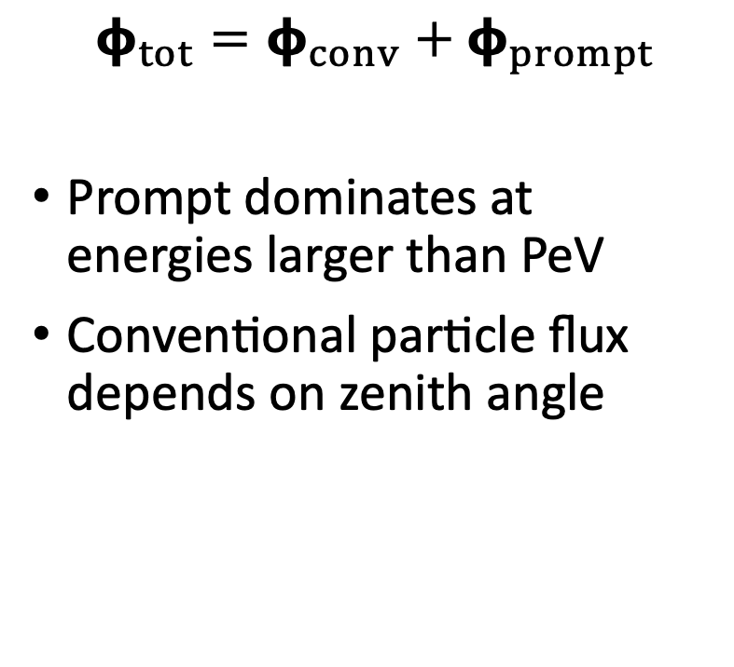
Muon flux
0°: perpendicular to Earth’s surface
$$φ_{tot}=φ_{conv}+φ_{prompt}$$
Prompt dominates at energies larger than PeV
Conventional particle flux depends on zenith angle
conventional
prompt

Slide 4
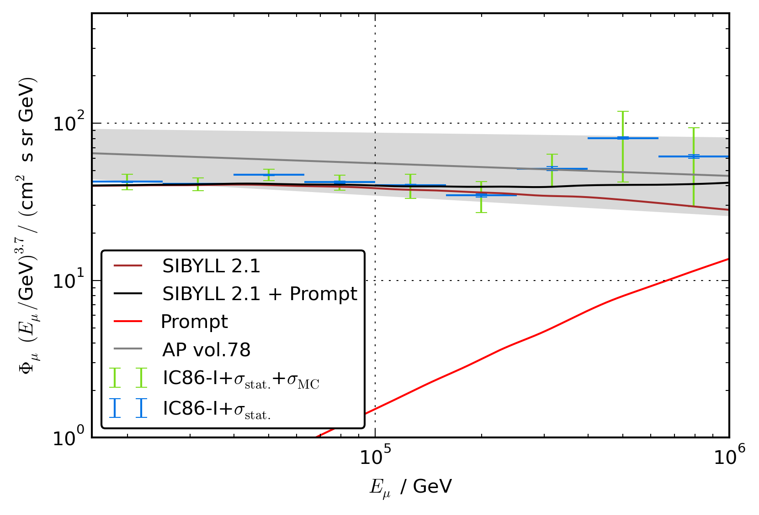
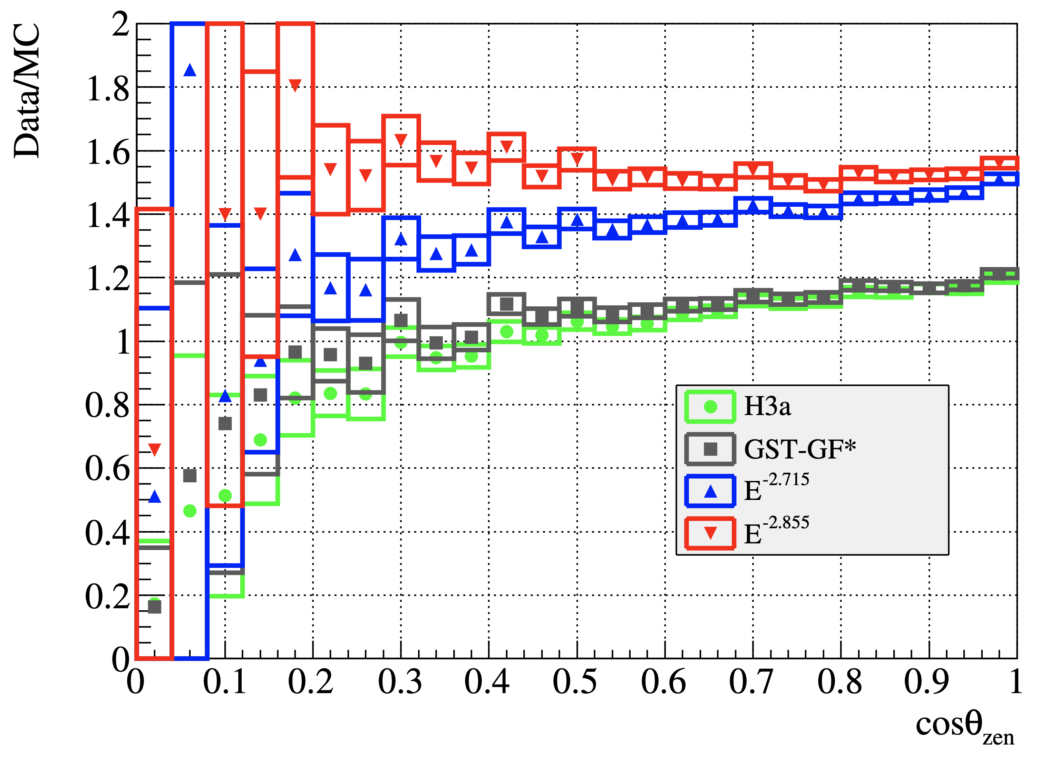
Previous analyses
Fit compatible with zero
MC uncertainties too large
Results promising, but zenith problem
[T. Fuchs, PhD Thesis, 10.17877/DE290R-17241]
[IceCube Collaboration, Astroparticle Physics, 10.1016/j.astropartphys.2016.01.006]

Slide 5
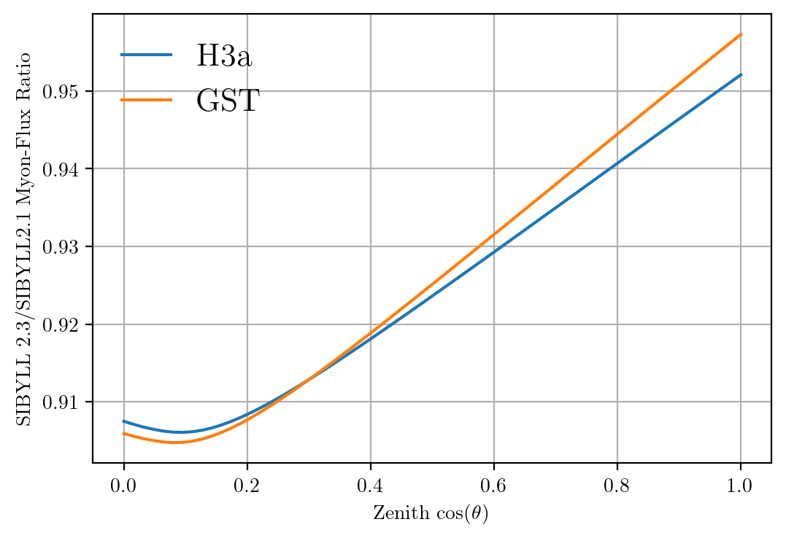
Solution to zenith problem?
No complete solution, but a step in the right direction

Slide 6
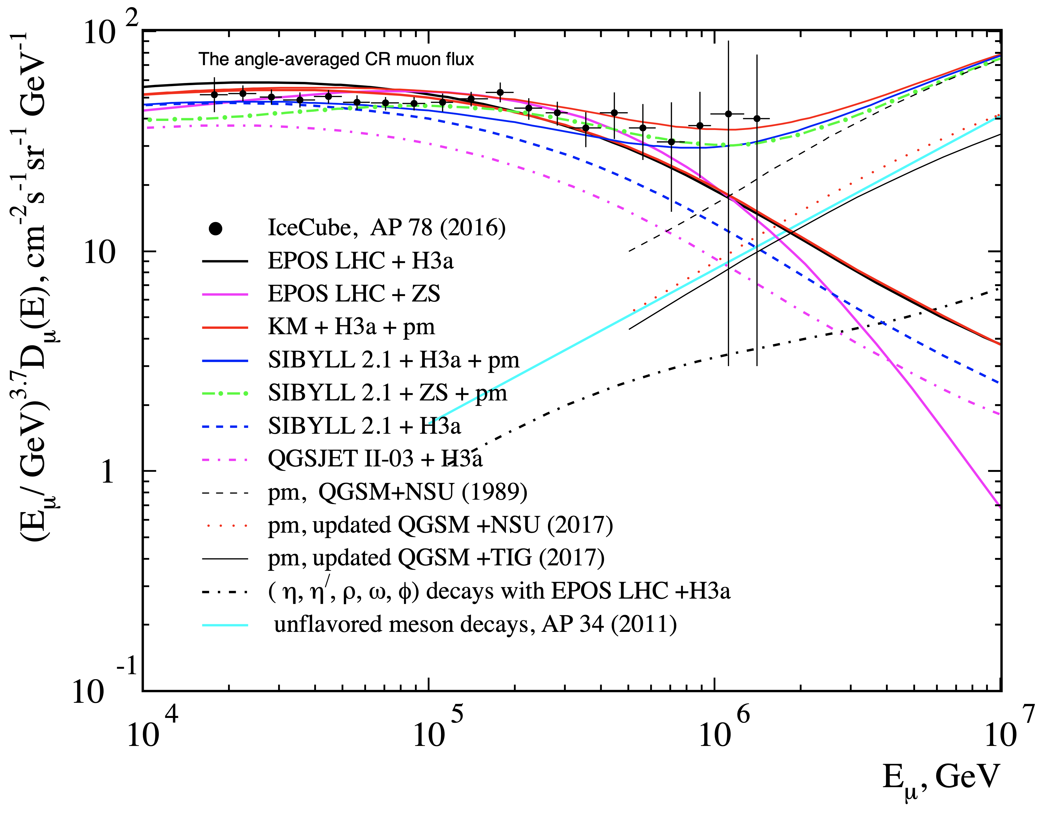
Observations
Mismatch between data and hadronic interaction models
No charm included in the past
Prompt was neglected
Fits better by adding prompt model
New simulations including charm
[Journal of Physics: Conf. Series. 2019. V. 1181, 012054]

Slide 7
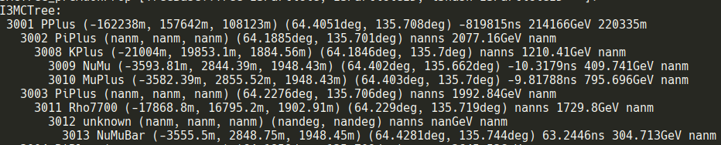
New ideas to measure the prompt component
Latest software CORSIKA 77420 and PROPOSAL
SIBYLL 2.3d → charm included
Use extended history option in CORSIKA → parent information
Tag muon parent particles in MC (prompt/conv)
Scale amount of prompt particles to create several datasets
Fit of prompt flux normalization
Get handle on hadronic interaction models
Scaling saves time and resources instead of doing multiple simulations with different interaction models
Analyze:
Muon energy
Zenith angle
Time (seasonal variations)
Conventional flux depends on the season
CORSIKA reader adopted
First simulations running
/data/sim/IceCube/2023/generated/CORSIKA_EHISTORY/

Slide 8
Identify prompt particles in air shower
CORSIKA 7
10 Mio. air showers (primary: proton)
Initial energy: 10⁵ – 10⁹ GeV
Two different injection angles 𝜃
SIBYLL 2.3d
Sampled from E⁻¹ , reweighted to Gaisser H3a
Extended history option to identify and tag the prompt particles manually
Deviations at energies > 10⁷ GeV
Maximum injected energy lower than the maximum possible energy (GZK cutoff at ~5 * 10¹⁰ GeV)
MCEq: SIBYLL 2.3c
Good agreement between CORSIKA and MCEq

Slide 9
Specific parent particle identification
CORSIKA 7 using SIBYLL 2.3d vs. SIBYLL 2.3c¹
Good agreement with unflavored particles
Mismatches occur for all the D-mesons
Issue not yet solved
Only protons simulated with CORSIKA
¹ Phys. Rev. D 100 (2019) 103018

Slide 10
Scaling of the prompt component - tagging
Amount of prompt particles is re-weighted with 0.5
Use tagging of prompt in CORSIKA MC
Conventional component is not much affected
If a shower contains prompt, almost no conv. particles in the shower arrive at the surface

Slide 11
Muon energy distributions
Highest energetic muon per shower/tree inside detector is shown
Too less statistics at high energies
Unknown: parent particle is not known → generation counter indicates, that there are particles between mother and muon → conventional

Slide 12
Who simulates what?
Many similar CORSIKA simulations are performed
Simulations are done on own branches
We should organize this and combine simulations
Saves time, resources and avoids unnecessary work

Slide 13
Summary
CORSIKA_EHIST works
Parent particles can be tagged
Good agreement with MCEq
Ready for the simulation/analysis
Next steps:
Simulate test data set
New event selection using DNN
Start analysis chain
Analyze zenith problem with new simulations
Future discussion:
How to extract physical parameters from effective scaling?
branching ratios (BR), cross-sections, particle physics
Scale BR and hadronic models compatible with LHC results
Thank you for your attention ☺️ @pgutjahr@icecube.wisc.edu

Slide 14
Backup

Slide 15
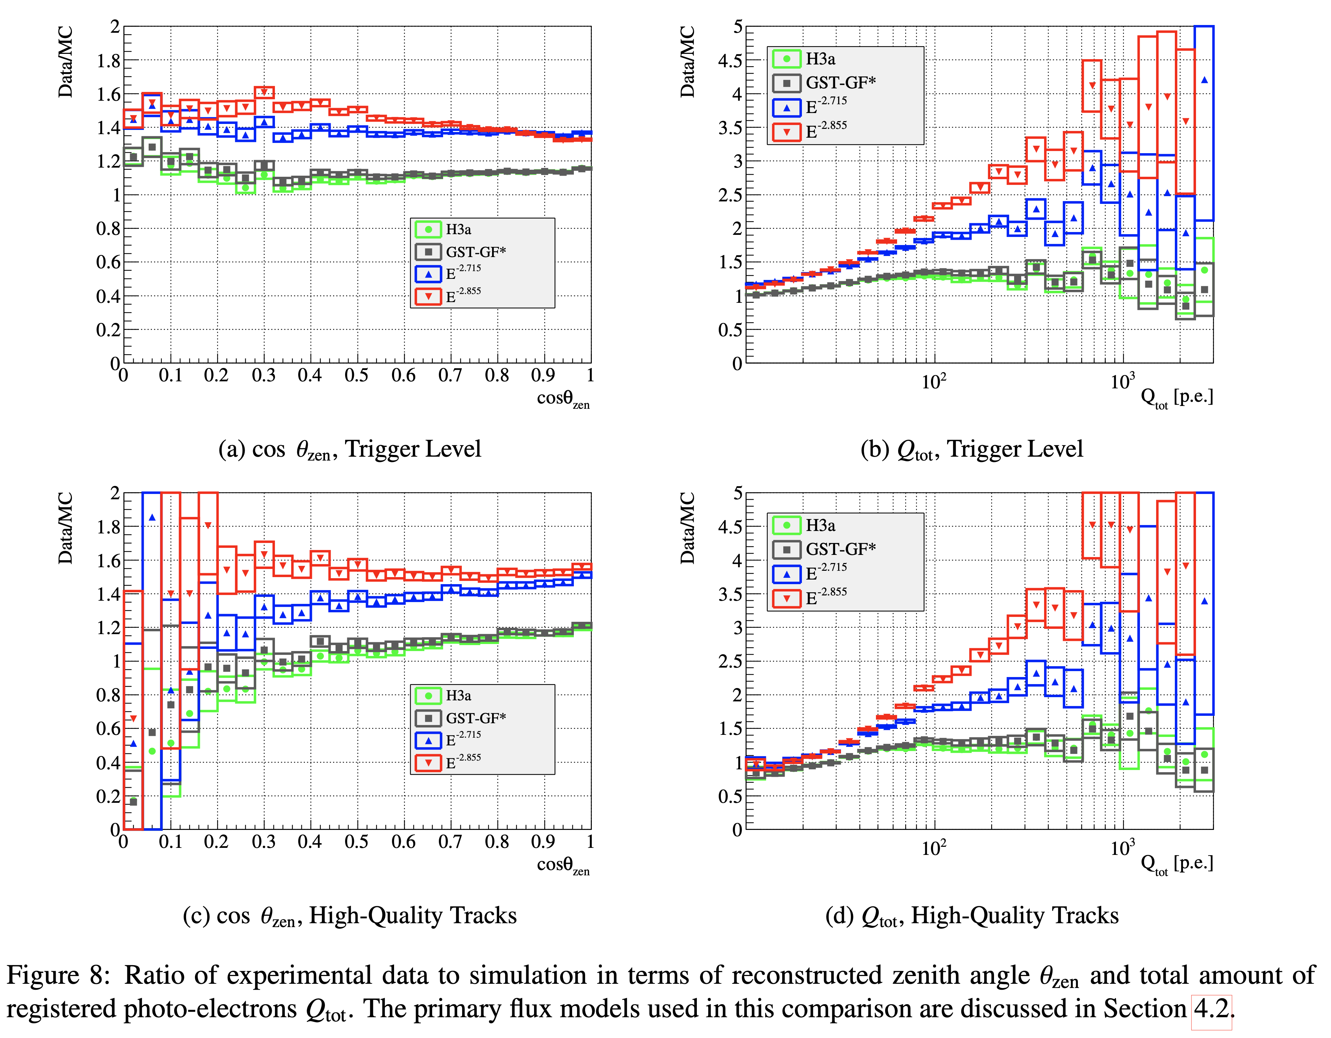
Backup: Zenith problem

Slide 16
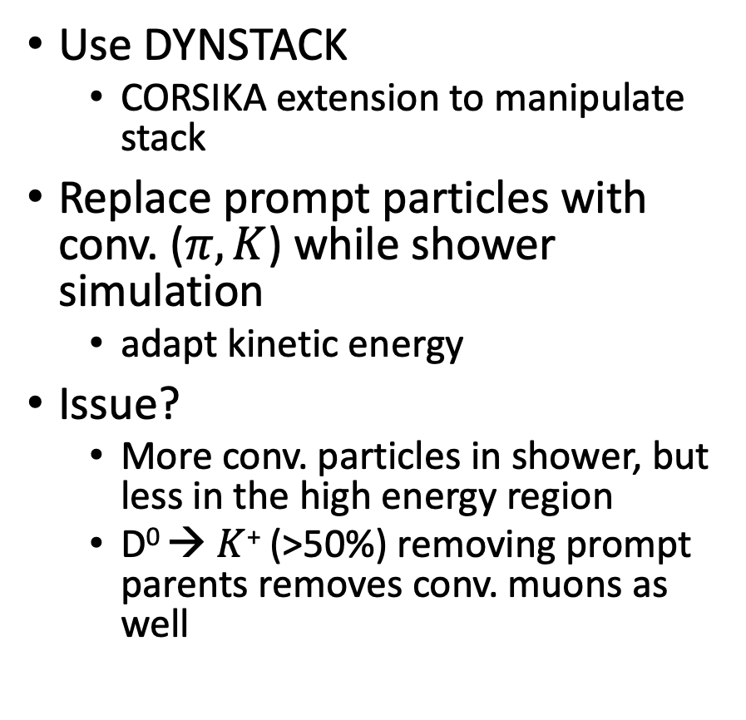
Backup: Scaling of the prompt component - DYNSTACK
Use DYNSTACK
CORSIKA extension to manipulate stack
Replace prompt particles with conv. ($π,Κ$) while shower simulation
adapt kinetic energy
Issue?
More conv. particles in shower, but less in the high energy region
D⁰ → $Κ$⁺ (>50%) removing prompt parents removes conv. muons as well

